Slide 1
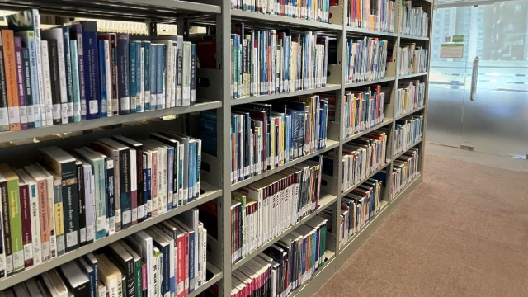
Library Orientation
AY2024-2025

Slide 2
Welcome to TWC Library!

Slide 3
ACCESS POINTS
On-site
Library at 5-6/F KP Campus
Learning Resources Centre at KH Campus
Book return (24x7)
5/F, KP Campus
Foyer@G/F, KPC
Lift Lobby@Tower B, MKC
Near the entrance of 1608A, KHC
Online help guides
e-Library (24x7) via -Library website
-TWC Search (Engine)
6/F, TST Campus
Notes:
As of 31 July 2021, the Library has a collection of more than 43,400 printed items and 4,760 multi-media items; over 3,633,000 titles of electronic books and dissertations in 16 platforms; and 54 electronic databases covering more than 16,000 full text e-journals titles.

Slide 4
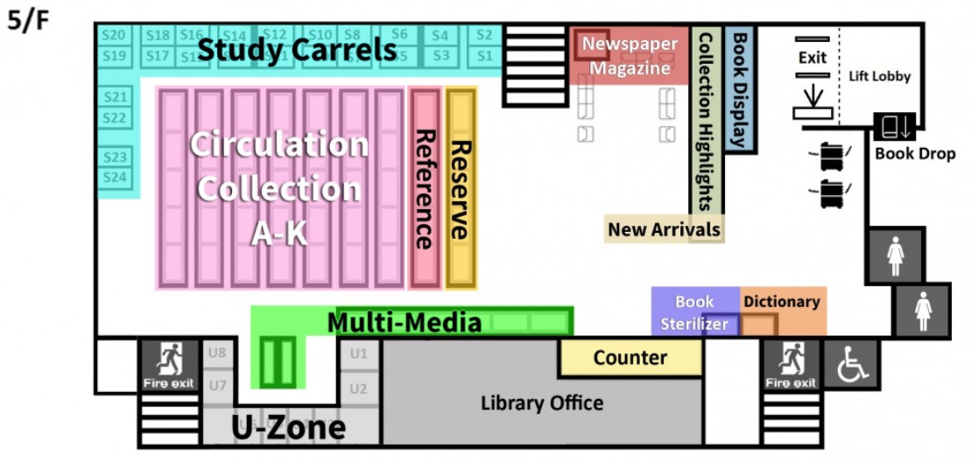
KPC Library 5/F Layout Plan

Slide 5
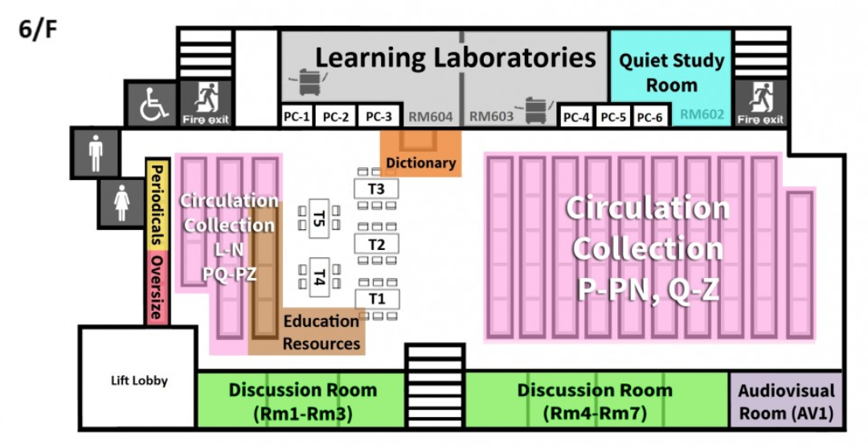
KPC Library 6/F Layout Plan

Slide 6
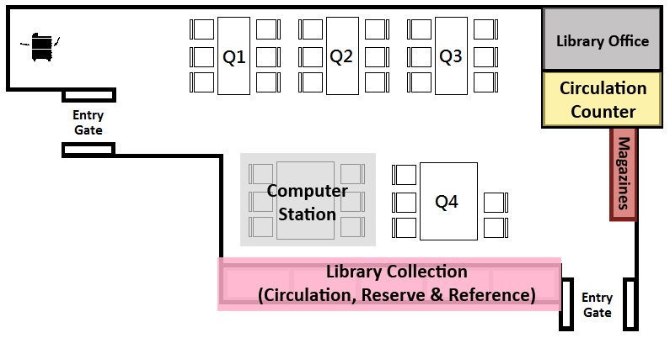
KHC Library Layout Plan

Slide 7
Physical Collection
Circulation Collection
Mainly books for normal loan
Reserve Collection
Essential readings or materials reserved for 3-Days.
Periodicals
Scholarly journals, professional and trade journals, magazines, as well as newspapers
Multi-media Collection
Mainly DVDs and DVD-ROMs

Slide 8
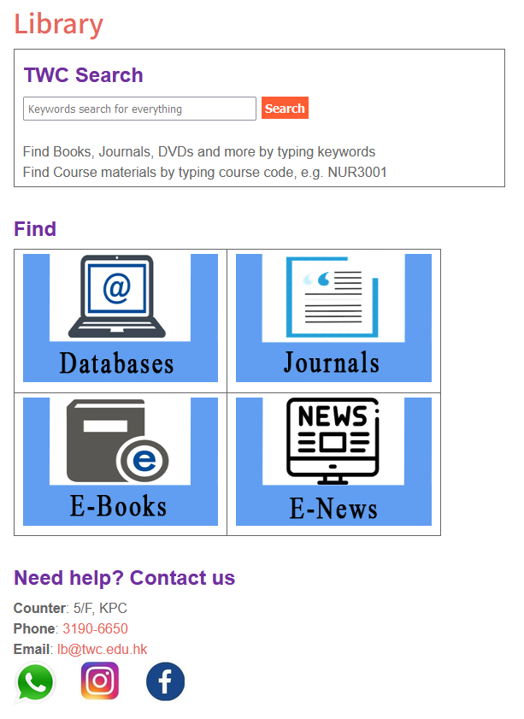
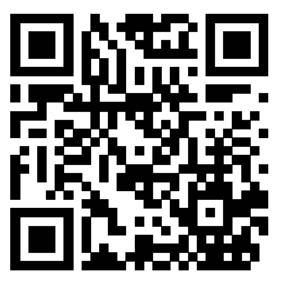
One-stop SEARCH
for all library resources
The FIRST Page covers >80% of your need!

Slide 9
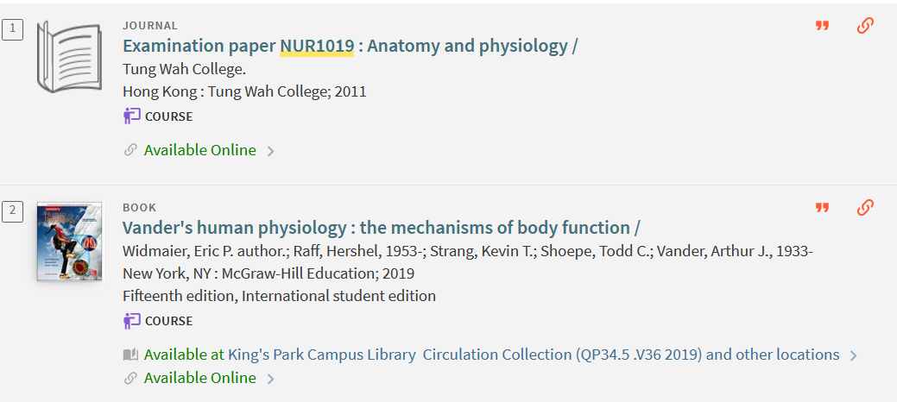
TWC Search
Course textbooks & reference materials
Type course code and search
Including both Reserve and Circulation Collection
Access point to TWC Examination paper

Slide 10
TWC Search – Subject Guide
Subject Guide
Esp. for your Major!
Try:
“Medical Science” “Nursing” “Psychology” “Management”

Slide 11
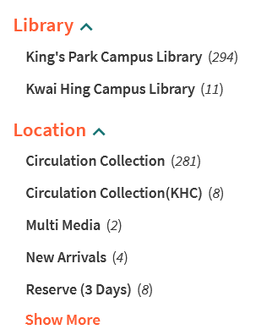
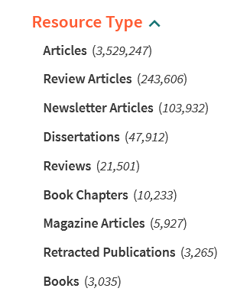
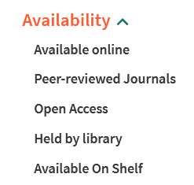
TWC Search – Filter your results
Available online
Anytime, anywhere with Internet

Slide 12
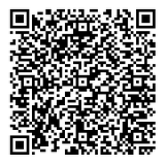
TWC Search
English Learning!
Road to IELTS
Study Skills
Writing
Pronunciation
Reading

Slide 13
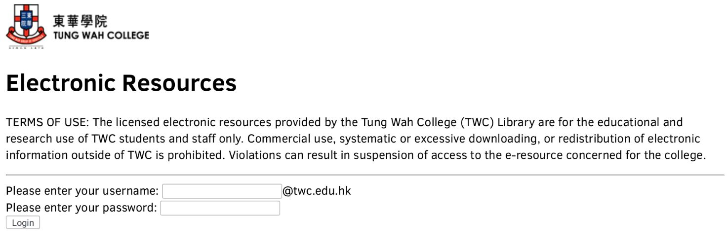
All Electronic Resources can be accessed remotely outside Campus ~ Login Details = TWC Email A/C

Slide 14
Library Orientations & Workshops
Week 2 / Week 3
Orientations: to familiarize new student with the library resources
Workshops: to introduce library services and search skills for assignments
Reference management with Mendeley

Slide 15
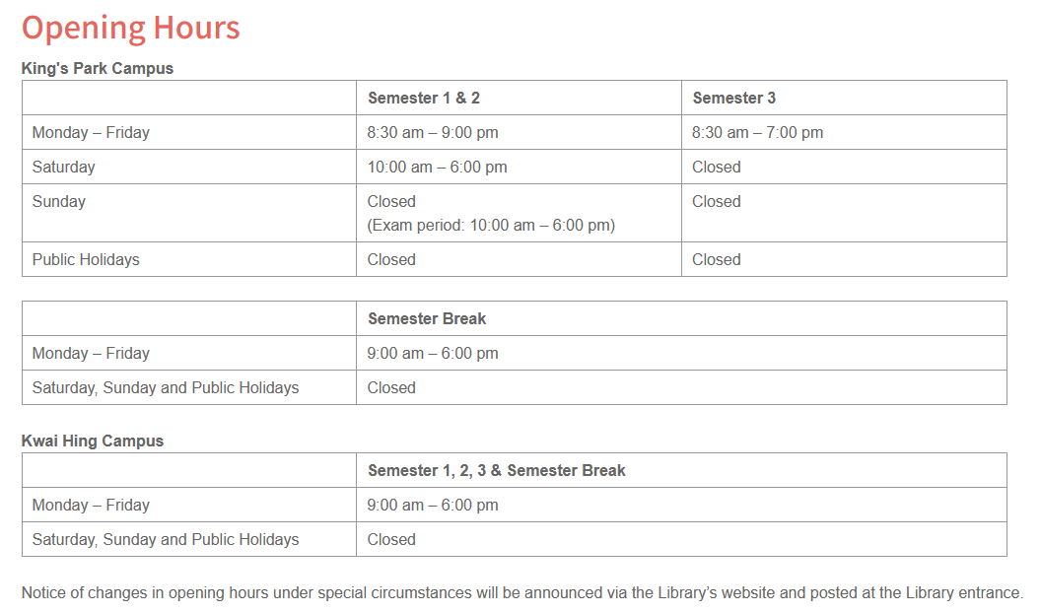
Library Opening Hours

Slide 16
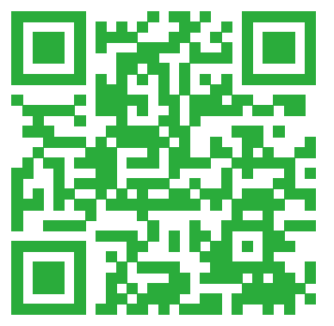
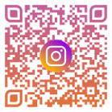
Contact us
Email: lb@twc.edu.hk
Phone: 3190 6650
WhatsApp: 5575 1564
Instagram: tungwahcollegelibrary
Facebook: 東華學院圖書館 Tung Wah College Library

